Slide 1
Management Stephen P. Robbins | Mary Coulter
Chapter 10 Designing Organizational Structure—Basic Designs

Slide 2
Learning Objectives
Describe six key elements in organizational design.
Know how to delegate work to others and develop your skill at delegating.
Contrast mechanistic and organic structures.
Discuss the contingency factors that favor either the mechanistic model or the organic model of organizational design.
Describe traditional organizational designs.
© Pearson Education Limited 2016

Slide 3
Traditional Approaches
Managers are reevaluating traditional approaches to find new structural designs that best support and facilitate employees’ doing the organization’s work—designs that can achieve efficiency but are also flexible.
The basic concepts of organization design formulated by early management writers, such as Henri Fayol and Max Weber, offered structural principles for managers to follow.
They still provide valuable insights into designing effective and efficient organizations. Of course, we’ve also gained a great deal of knowledge over the years as to their limitations.
© Pearson Education Limited 2016

Slide 4
Designing Organizational Structure
Organizing – Arranging and structuring work to accomplish an organization’s goals.
Organizational Structure – The formal arrangement of jobs within an organization.
© Pearson Education Limited 2016

Slide 5
Designing Organizational Structure
Organizational Chart – The visual representation of an organization’s structure.
Organizational Design – A process involving decisions about six key elements:
Work specialization
Departmentalization
Chain of command
Span of control
Centralization and decentralization
Formalization
© Pearson Education Limited 2016

Slide 6
1. Work Specialization
Dividing work activities into separate job tasks.
Individual employees “specialize” in doing part of an activity rather than the entire activity in order to increase work output.
Early proponents of work specialization believed it could lead to great increases in productivity.
Overspecialization can result in human diseconomies such as boredom, fatigue, stress, poor quality, increased absenteeism, and higher turnover.
© Pearson Education Limited 2016

Slide 7
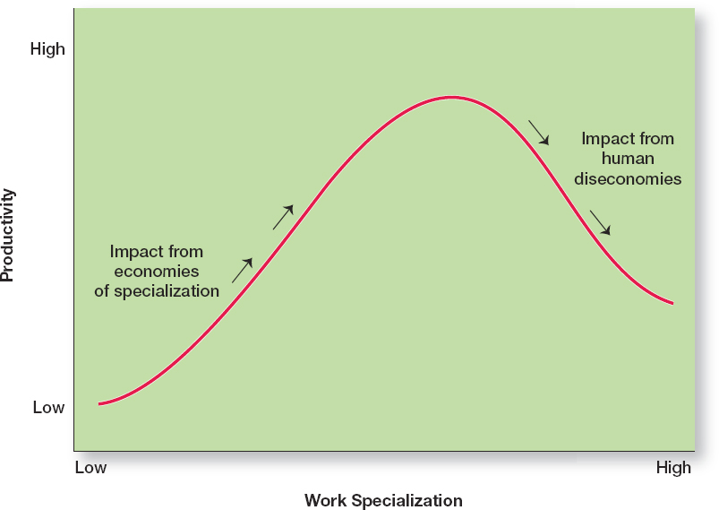
Exhibit 10-2 Economies and Diseconomies of Work Specialization
© Pearson Education Limited 2016

Slide 8
2. Departmentalization
The basis on which jobs are grouped together is called departmentalization. Five common forms of departmentalization:
Functional
Product
Geographical
Process
Customer
© Pearson Education Limited 2016

Slide 9
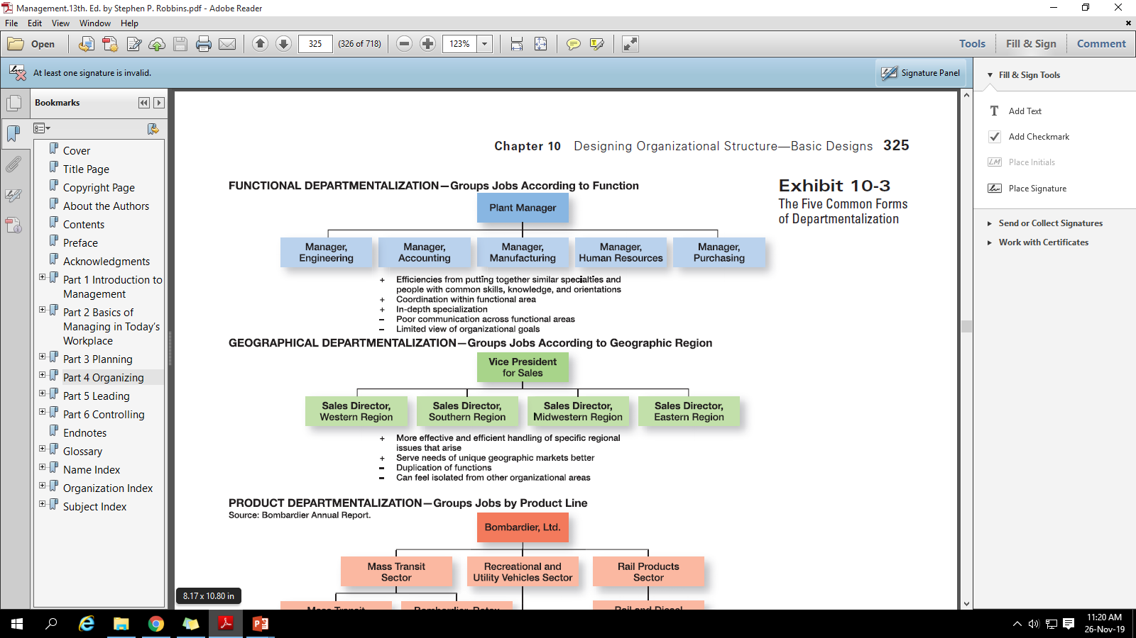
Functional Departmentalization
© Pearson Education Limited 2016

Slide 10
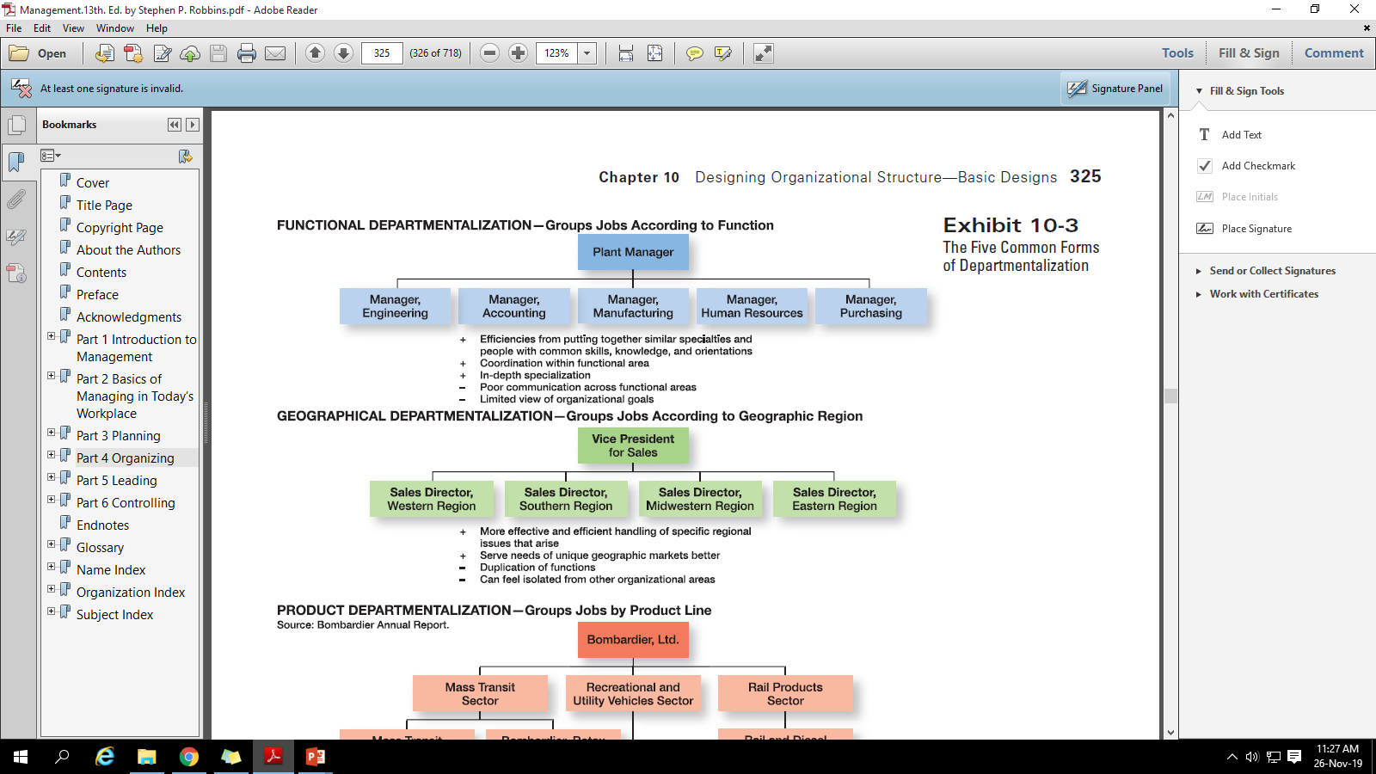
Geographical Departmentalization
© Pearson Education Limited 2016

Slide 11
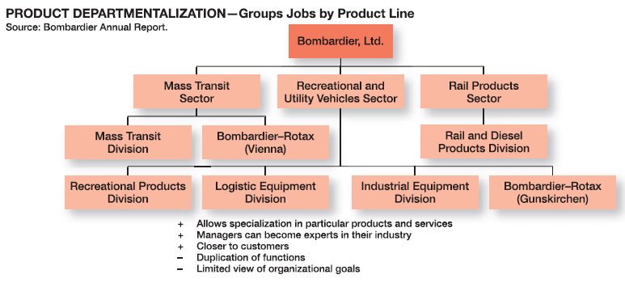
Product Departmentalization
© Pearson Education Limited 2016

Slide 12
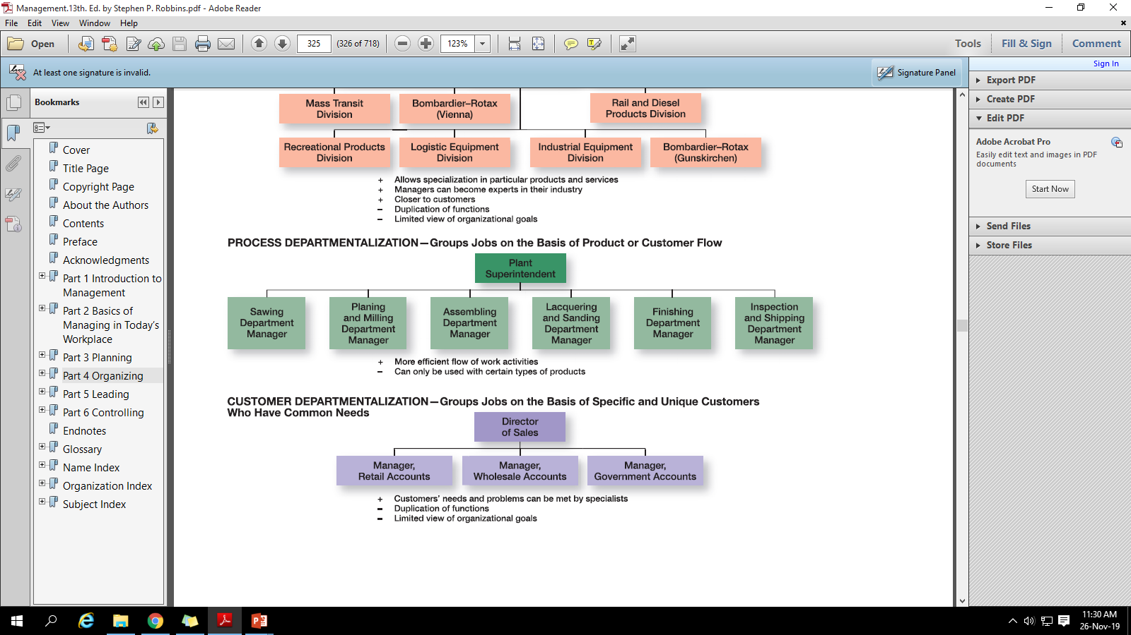
Process Departmentalization
© Pearson Education Limited 2016

Slide 13

Customer Departmentalization
© Pearson Education Limited 2016

Slide 14
Trends in Departmentalization
Increasing use of Customer Departmentalization
Getting and keeping customers is essential for success.
This approach emphasizes on monitoring and responding to changes in customers’ needs.
Increasing use of use of teams
Diverse skills are needed to accomplish complex work tasks.
Organizations are using a cross-functional team, a work team composed of individuals from various functional specialties.
© Pearson Education Limited 2016

Slide 15
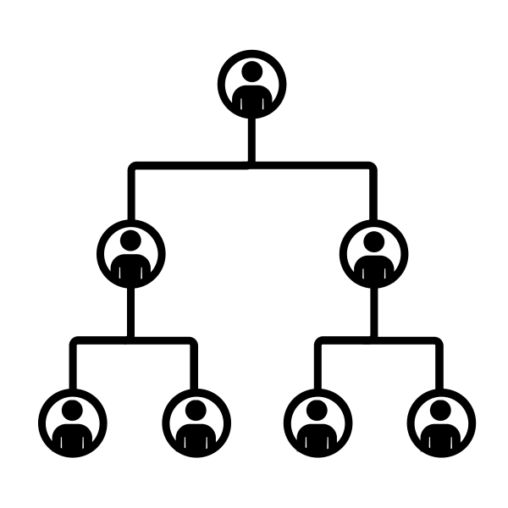
3. Chain of Command
The chain of command is the line of authority extending from upper organizational levels to lower levels, which clarifies who reports to whom.
It helps employees with questions such as “Who do I report to?” or “Who do I go to if I have a problem?”
© Pearson Education Limited 2016

Slide 16
Authority
Authority refers to the rights inherent in a managerial position to tell people what to do and to expect them to do it.
Managers in the chain of command had authority to do their job of coordinating and overseeing the work of others.
Authority could be delegated downward to lower-level managers, giving them certain rights with limitations.
© Pearson Education Limited 2016

Slide 17
Authority
Acceptance Theory of Authority – The view proposed by Chester Bernard that authority comes from the willingness of subordinates to accept it.
Subordinates will accept orders only if the following conditions are satisfied:
1. They understand the order.
2. They feel the order is consistent with the organization’s purpose.
3. The order does not conflict with their personal beliefs.
4. They are able to perform the task as directed.
© Pearson Education Limited 2016

Slide 18
Authority
Line authority – Authority that entitles a manager to direct the work of an employee.
Staff Authority – Positions with some authority that have been created to support, assist, and advise those holding line authority.
© Pearson Education Limited 2016

Slide 19
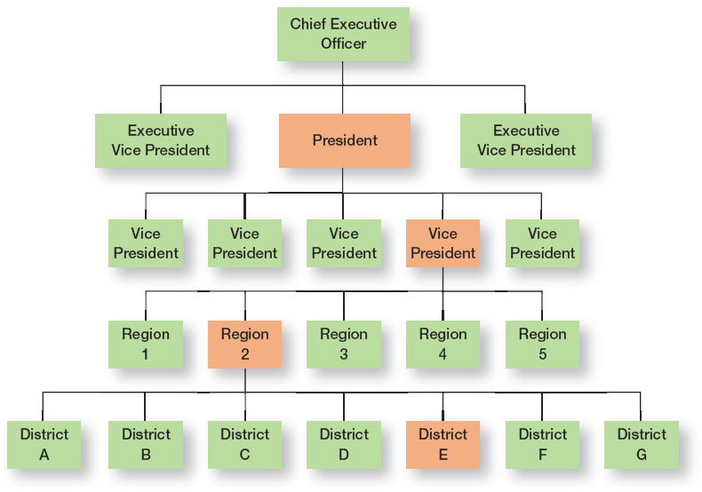
Exhibit 10-4 Chain of Command & Line Authority
© Pearson Education Limited 2016

Slide 20
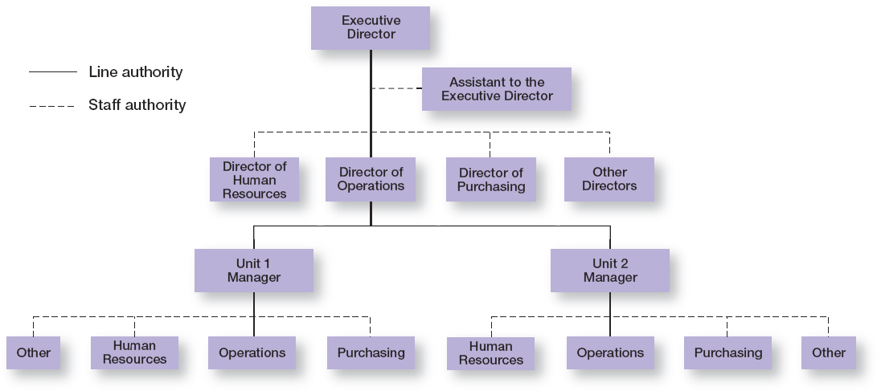
Exhibit 10-5 Line Versus Staff Authority
© Pearson Education Limited 2016

Slide 21
Responsibility
The obligation or expectation to perform.
When managers use their authority to assign work to employees, those employees take on an obligation to perform those assigned duties.
Employees should be held accountable for their performance!
© Pearson Education Limited 2016

Slide 22
Unity of Command
Unity of Command – The management principle that each person should report to only one manager.
One of Fayol’s 14 management principles.
Without unity of command, conflicting demands from multiple bosses may create problem.
© Pearson Education Limited 2016

Slide 23
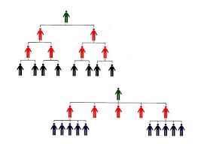
4. Span of Control
The number of employees a manager can efficiently and effectively manage.
The traditional view was that managers could not—and should not—directly supervise more than five or six subordinates.
It determines the number of levels and managers in an organization.
© Pearson Education Limited 2016

Slide 24
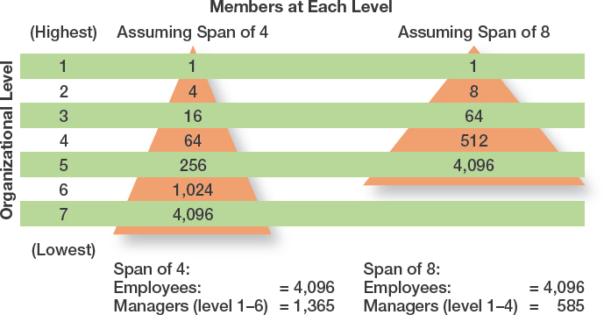
Exhibit 10-6 Contrasting Spans of Control
© Pearson Education Limited 2016

Slide 25
5. Centralization and Decentralization
Centralization is the degree to which decision making takes place at upper levels of the organization. If top managers make key decisions with little input from below, then the organization is more centralized.
Decentralization is the degree to which lower-level employees provide input or actually make decisions. The more that lower-level employees provide input or actually make decisions, the more decentralization there is.
Employee Empowerment – Giving employees more authority (power) to make decisions
© Pearson Education Limited 2016

Slide 26
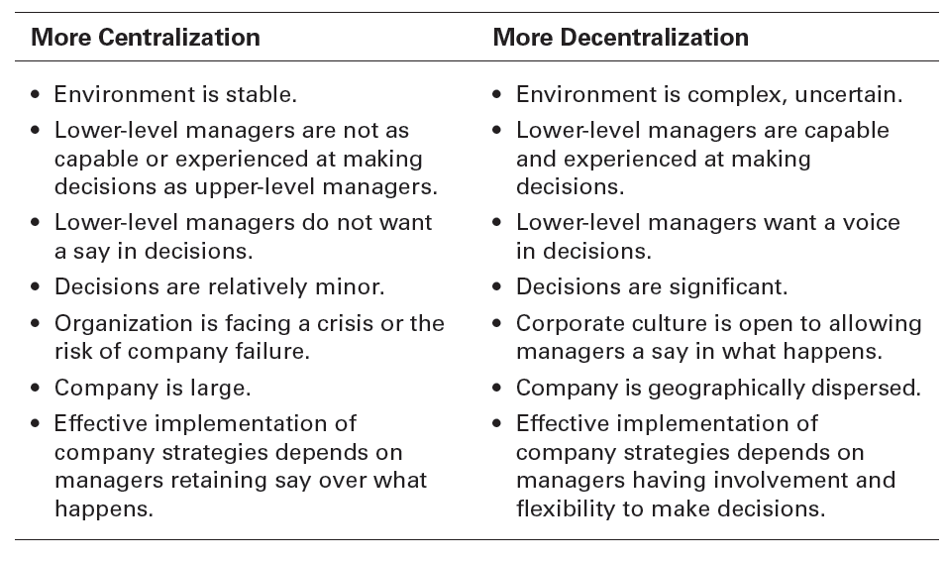
Exhibit 10-7 Centralization or Decentralization
© Pearson Education Limited 2016

Slide 27
6. Formalization
Formalization refers to how standardized an organization’s jobs are and the extent to which employee behavior is guided by rules and procedures.
Highly formalized organizations – Employees have little discretion over what’s done, when it’s done, and how it’s done.
Less formalized organizations – Employees have more discretion in how they do their work.
© Pearson Education Limited 2016

Slide 28
Mechanistic and Organic Structures
Mechanistic Organization - An organizational design that’s rigid and tightly controlled.
Organic Organization – An organizational design that’s highly adaptive and flexible.
© Pearson Education Limited 2016

Slide 29
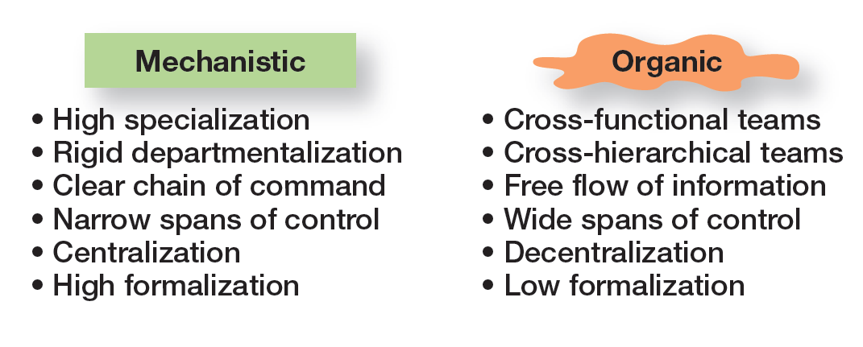
Exhibit 10-8 Mechanistic Versus Organic Organizations
© Pearson Education Limited 2016

Slide 30
Contingency Factors Affecting Structural Choice
Strategy and Structure – An organization’s structure should facilitate goal achievement.
Strategy and structure should be closely linked.
Changes in corporate strategy should lead to changes in an organization’s structure that support the strategy.
Certain structural designs work best with different organizational strategies.
Organic structure works well when an organization is pursuing meaningful and unique innovations.
Mechanistic organization works best for companies wanting to tightly control costs.
© Pearson Education Limited 2016

Slide 31
Contingency Factors Affecting Structural Choice
Size and Structure – As an organization grows larger, its structure tends to change from organic to mechanistic with increased specialization, departmentalization, centralization, and rules/regulations.
© Pearson Education Limited 2016

Slide 32
Contingency Factors Affecting Structural Choice
Technology and Structure
Organizations adapt their structures to their technology.
Woodward’s classification of firms based on the complexity of the technology employed:
Unit production of single units or small batches.
Mass production of large batches of output.
Process production in continuous process of outputs.
© Pearson Education Limited 2016

Slide 33
Contingency Factors Affecting Structural Choice
Environmental Uncertainty and Structure
Managers try to minimize environmental uncertainty by adjusting the organization’s structure.
In stable and simple environments with little uncertainty, mechanistic designs can be more effective.
In dynamic and complex environments with a lot of uncertainty, there is a need of flexibility of an organic design.
© Pearson Education Limited 2016

Slide 34
Contingency Factors Affecting Structural Choice
Simple Structure – An organizational design with low departmentalization, wide spans of control, centralized authority, and little formalization.
Functional Structure – An organizational design that groups together similar or related occupational specialties.
Divisional Structure – An organizational structure made up of separate, semiautonomous units or divisions.
© Pearson Education Limited 2016

Slide 35
Review Learning Objective 10.1
Describe six key elements in organizational design.
The key elements in organizational design are:
Work specialization
Chain of command
Span of control
Departmentalization
Centralization-decentralization
Formalization
© Pearson Education Limited 2016

Slide 36
Review Learning Objective 10.2
Contrast mechanistic and organic structures.
Mechanistic organization – A rigid and tightly controlled structure.
Organic organization – Highly adaptive and flexible.
© Pearson Education Limited 2016

Slide 37
Review Learning Objective 10.3
Discuss the contingency factors that favor either the mechanistic model or the organic model of organizational design.
Structural decisions are influenced by:
Overall strategy of the organization
Size of the organization
Technology use employed by the organization
Degree of environmental uncertainty
© Pearson Education Limited 2016

Slide 38
Review Learning Objective 10.4
Describe traditional organizational designs.
Simple structure – Low departmentalization, wide spans of control, authority centralized in a single person, and little formalization.
Functional structure – Groups similar or related occupational specialties together.
Divisional structure – Made up of separate business units or divisions.
© Pearson Education Limited 2016

